Slide 1

CSYE7374 Parallel Machine Learning & AI
Detecting malicious mining pool behavior within Nakamoto consensus using parallelized ML
Presented By
Srinjoy Chakravarty
Srishti Ashok Mishra

Slide 2
Introduction
What is the Blockchain System?¶
“A blockchain is a time-stamped series of an immutable record of data that is managed by a cluster of computers not owned by any single entity. Each of these blocks of data is secured and bound to each other using cryptographic principles”. In simple terms, blockchain is a chain of blocks; the words “block” and “chain” are the digital information and public database, respectively. The core components of blockchain architecture:
Node — user or computer within the blockchain
Transaction — smallest building block of a blockchain system
Block — a data structure used for keeping a set of transactions which is distributed to all nodes in the network
Chain — a sequence of blocks in a specific order
Miners — specific nodes which perform the block verification process
Consensus— a set of rules and arrangements to carry out blockchain operation

Slide 3
Objective
By clustering address signatures, we can identify mining entities and their potentially malicious behavior on the network to help the community make more responsible mining decisions.

Slide 4
Methodology
Confusion Matrix
F1 Score
F-beta score
Precision-recall Curve
Precision Score
Random Forest Classifier
Recall Score

Slide 5
Analysis :​

Slide 6
Libraries:

Slide 7
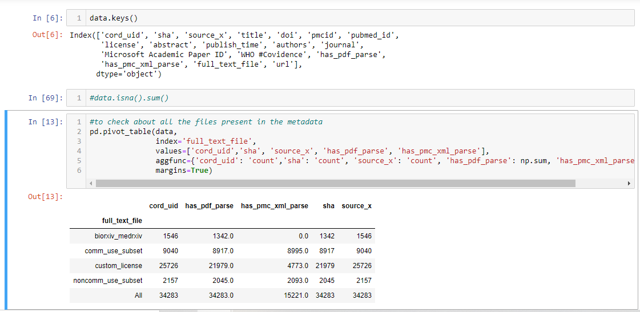
1. Data Extraction and Preparation

Slide 8
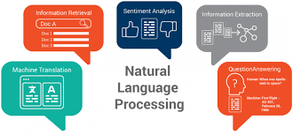
2. Natural Language Processing
NLP is a branch of data science that consists of systematic processes for analyzing, understanding, and deriving information from the text data in a smart and efficient manner.

Slide 9
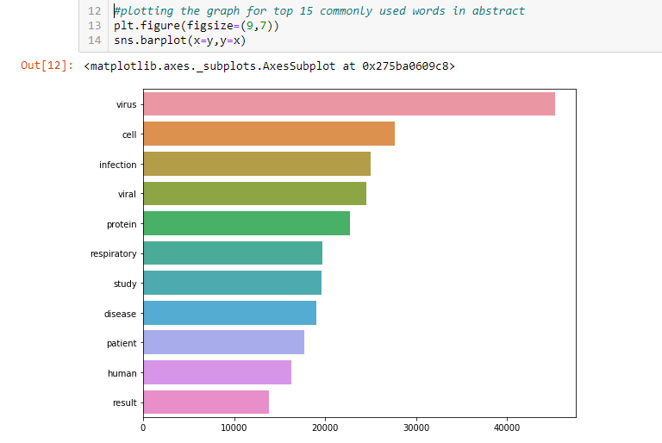
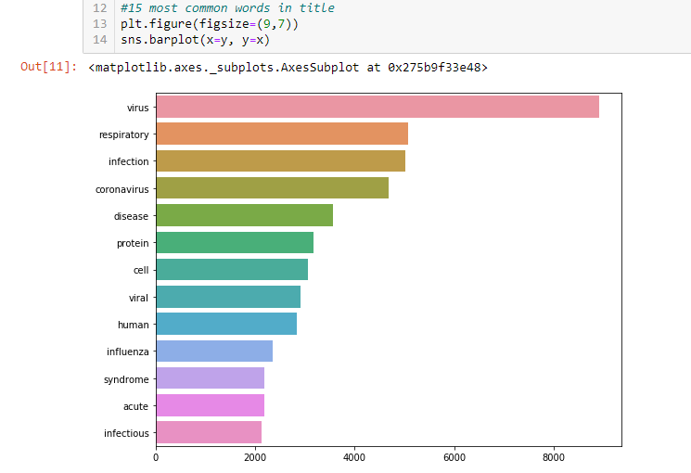
Most common words from title and abstract

Slide 10
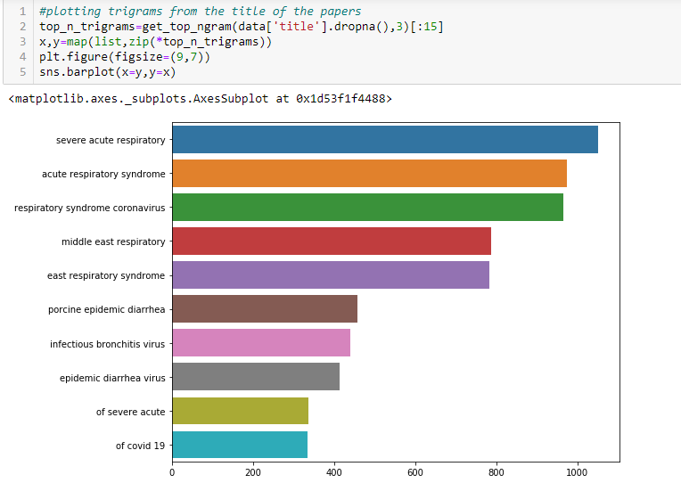
Ngrams
Ngrams are a set of co-occurring or continuous sequence of n items from a sequence of large text or sentence.

Slide 11
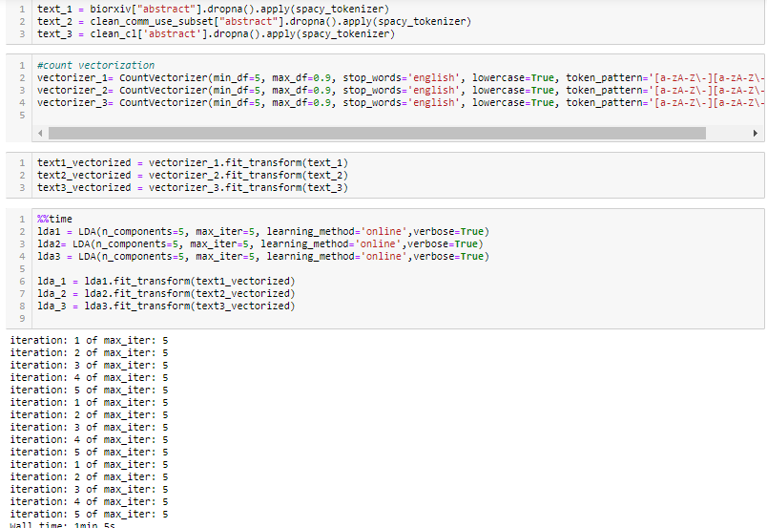
Topic Modelling

Slide 12
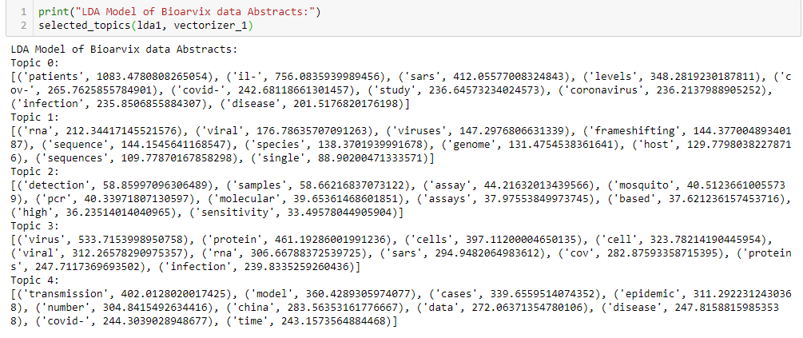
LDA
Latent Dirichlet Allocation (LDA) is a “generative probabilistic model” of a collection of composites made up of parts. Its uses include Natural Language Processing (NLP) and topic modelling

Slide 13
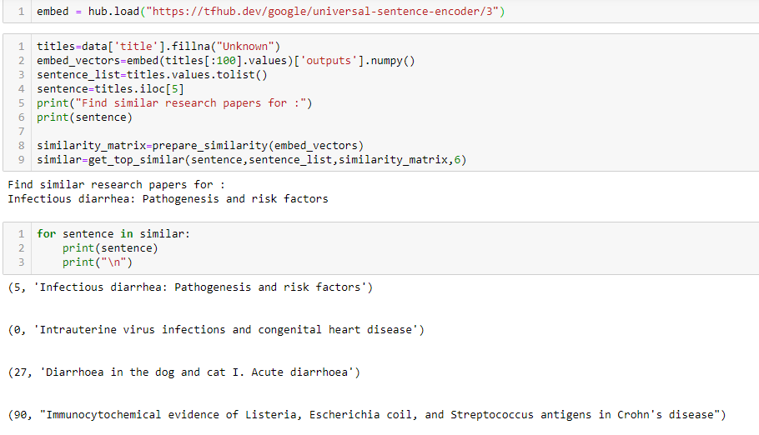
Similarity of words from the research paper

Slide 14
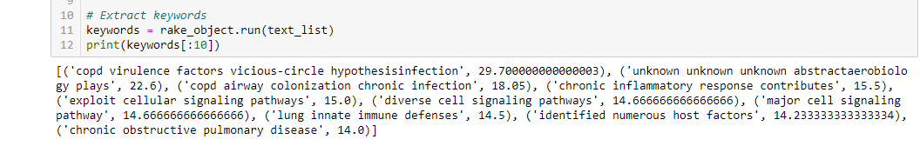
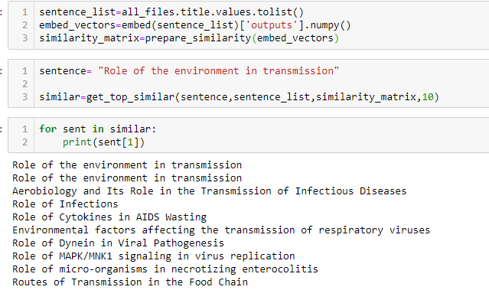
Keyword extraction and sentence similarity
Keyword extraction is the automated process of extracting the most relevant words and expressions from text.
It helps summarize the content of a text and recognize the main topics which are being discussed.

Slide 15
Knowledge Graph
A Knowledge Graph is a set of datapoints linked by relations that describe a domain
Knowledge Graphs are secondary or derivate datasets
Obtained by analyzing and filtering the original data
More specifically, the relations between data points are pre-calculated

Slide 16
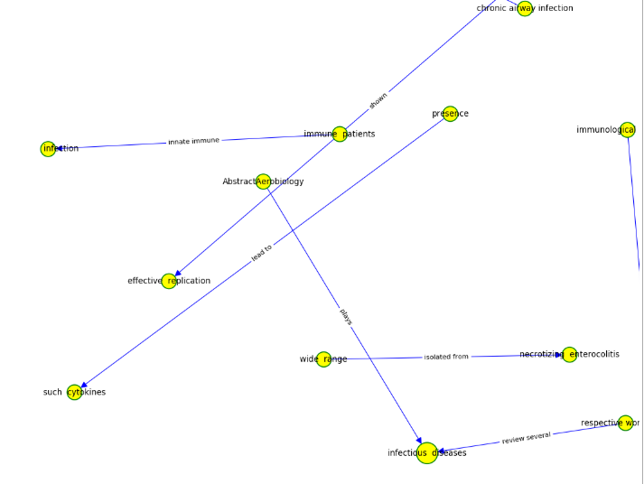
Knowledge Graph

Slide 17
Web Scraping and Geospatial Analysis
Web Scraping: Extracting data from websites using Python libraries
Geospatial Analysis:
Gathering, display, and manipulation of imagery, and historical coronavirus cases data
Described explicitly in terms of geographic coordinates (Latitude and Longitude) using GeoPandas libraries

Slide 18
Libraries Used
from bs4 import BeautifulSoup
import requests
import numpy as np
import pandas as pd
import matplotlib.pyplot as plt
import seaborn as sns
import geopandas as gpd
from shapely.geometry import Point, Polygon
import descartes
from mpl_toolkits.axes_grid1 import make_axes_locatable
import mapclassify

Slide 19
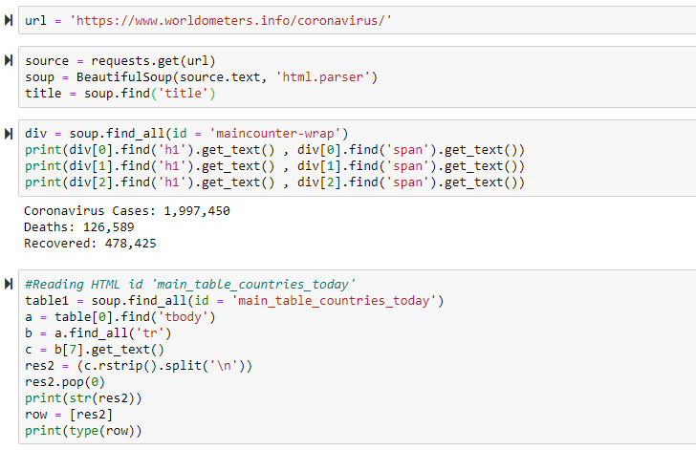
Scraping Updated Coronavirus Data from Worldometer for all the countries

Slide 20
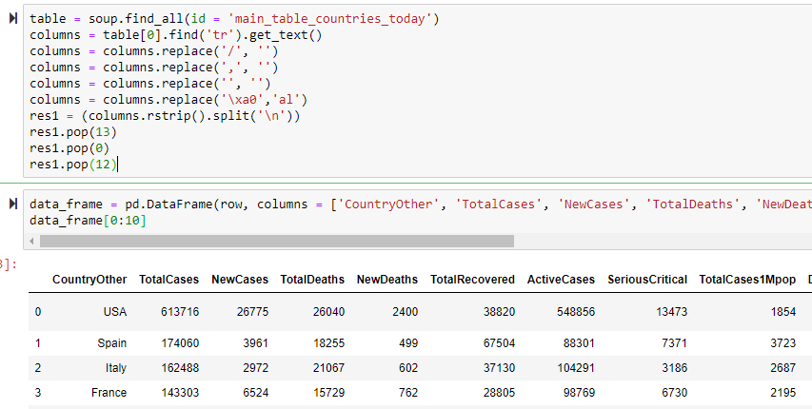
Data Cleaning

Slide 21
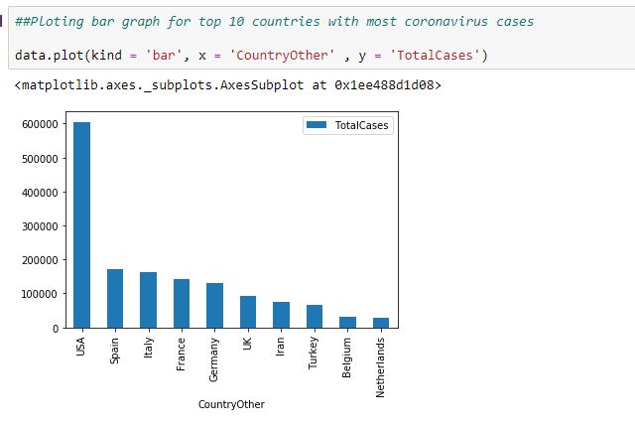
Visualization

Slide 22
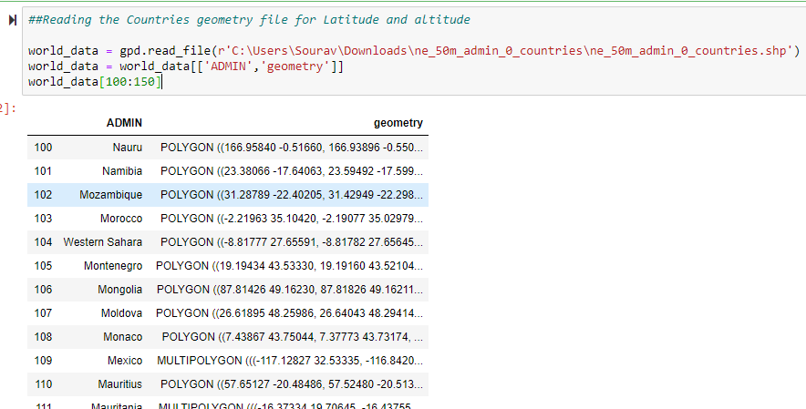
Reading the Countries geometry file for Latitude and Longitude

Slide 23
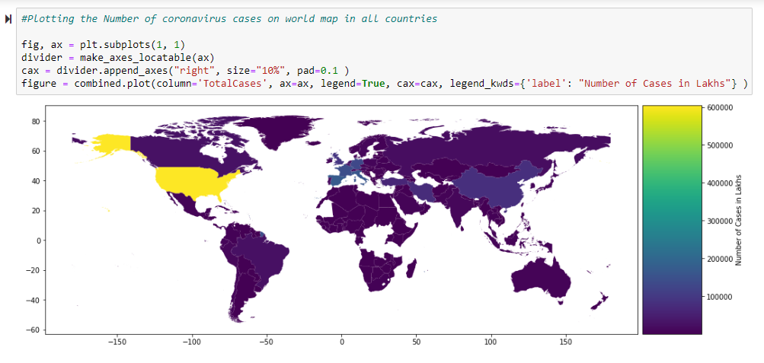
Plotting the countries with most coronavirus cases on world map

Slide 24
Time Series Forecasting
Predicting Coronavirus Outbreak and Recovering Rate with FB Prophet
There could be lots of influencing factors in future hence prediction can be wrong. Factors like
Change in data
Presence of Effective Treatment
Vaccine can influence prediction

Slide 25
Libraries Used for Time Series Forecasting
import pandas as pd
from fbprophet import Prophet
import fbprophet
import matplotlib.pyplot as plt
from fbprophet.plot import add_changepoints_to_plot

Slide 26
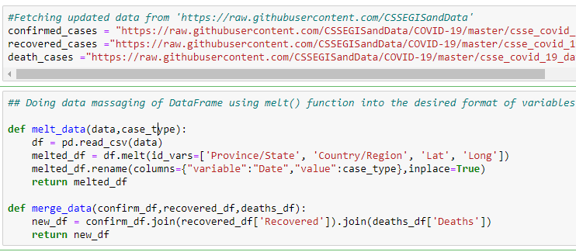
Fetching Updated data from https://raw.githubusercontent.com/CSSEGISandData and doing data massaging of DataFrame using melt() function

Slide 27
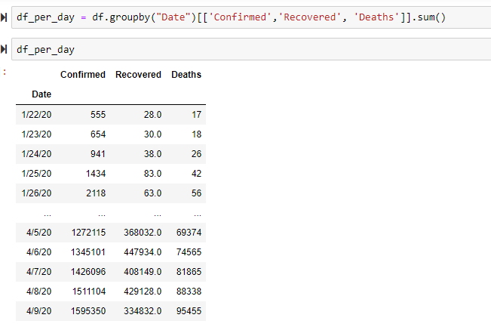
Data Manipulation

Slide 28
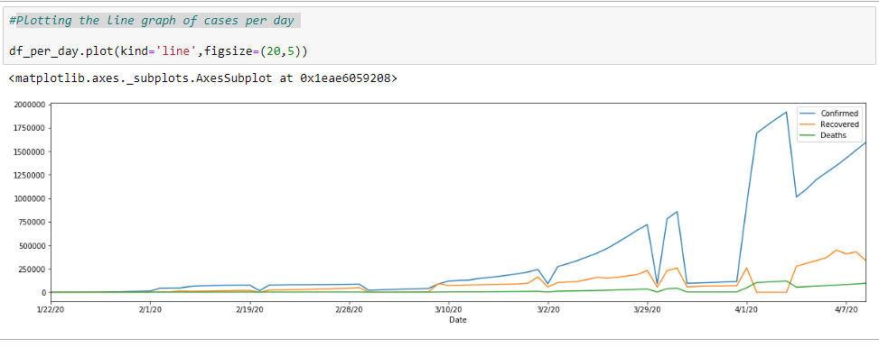
Plotting the line graph of cases per day

Slide 29
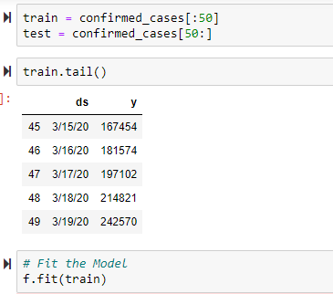
Train and Test the data

Slide 30
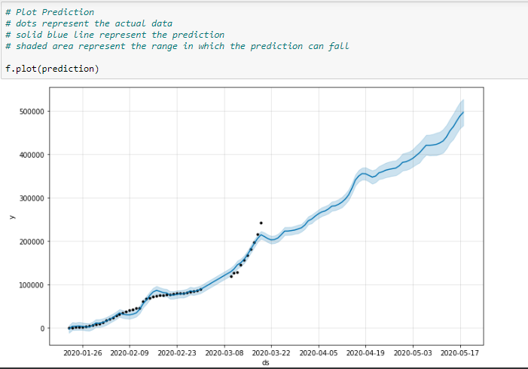
dots represent the actual data
solid blue line represent the prediction
shaded area represent the range in which the prediction can fall

Slide 31
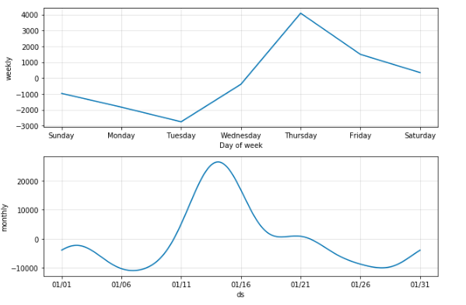
Monthly and Weekly Trend

Slide 32
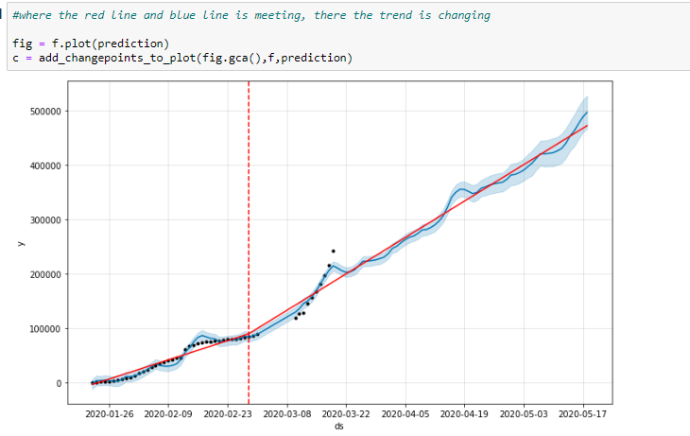
Find the points and dates where there is change in trend

Slide 33
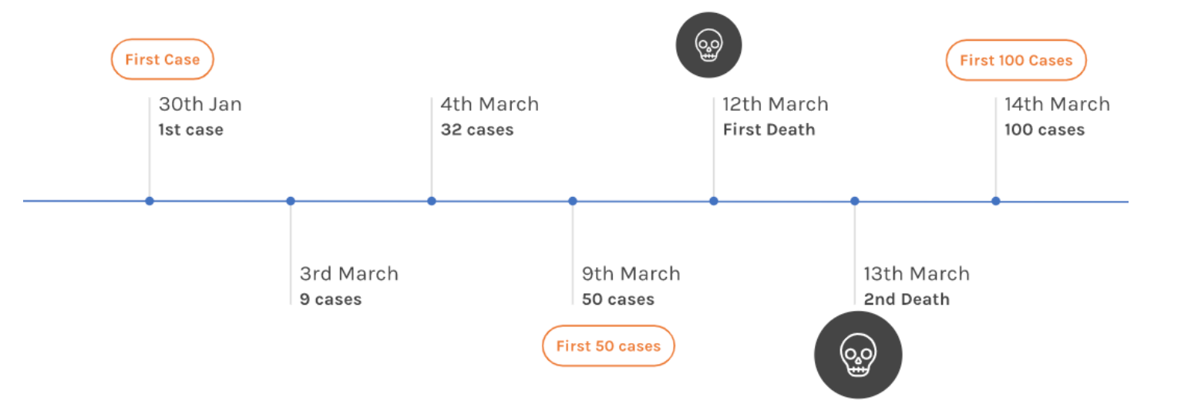
Data Analysis(Tracking India's Coronavirus Spread)

Slide 34
Analyzing the present condition in India
The first COVID-19 case was reported on 30 January with a student who arrived in Kerala state from Wuhan
Then 2 more cases were reported in the next 2 days in Kerala again
No new cases was reported in India for a month,
On 8th March, five new cases of corona virus in Kerala were again reported
Since then the cases have been rising

Slide 35
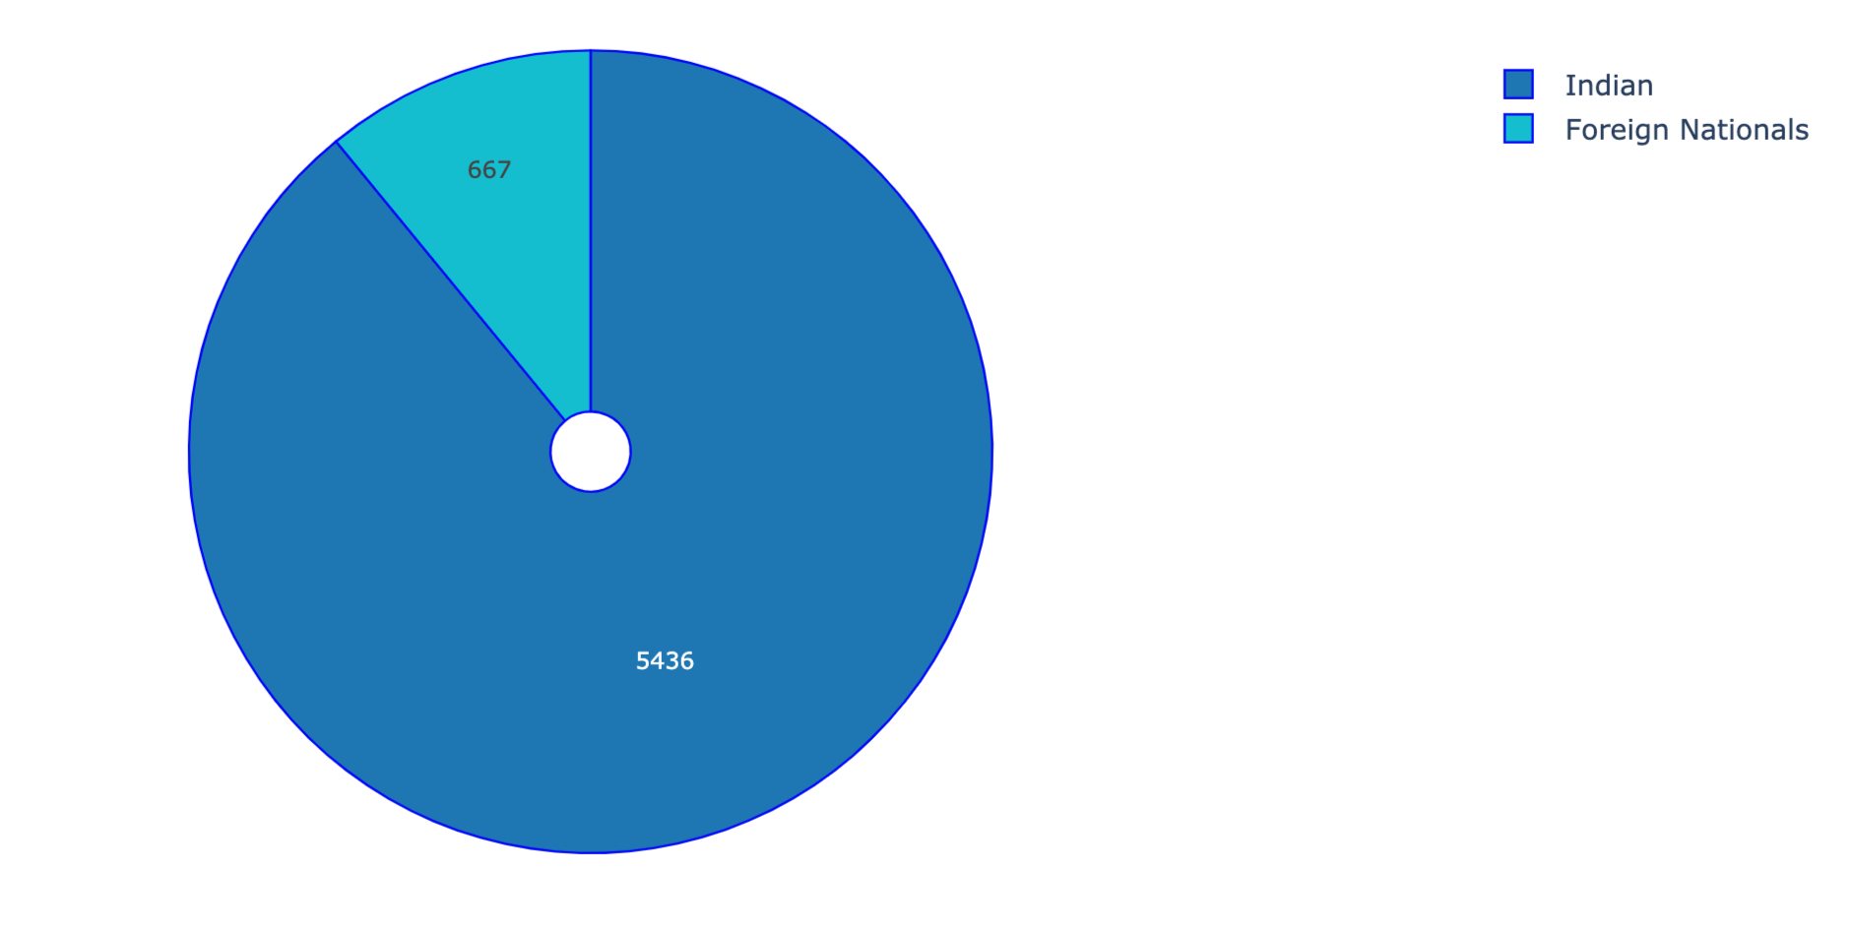

Distribution of Cases in India by Nationality

Slide 36
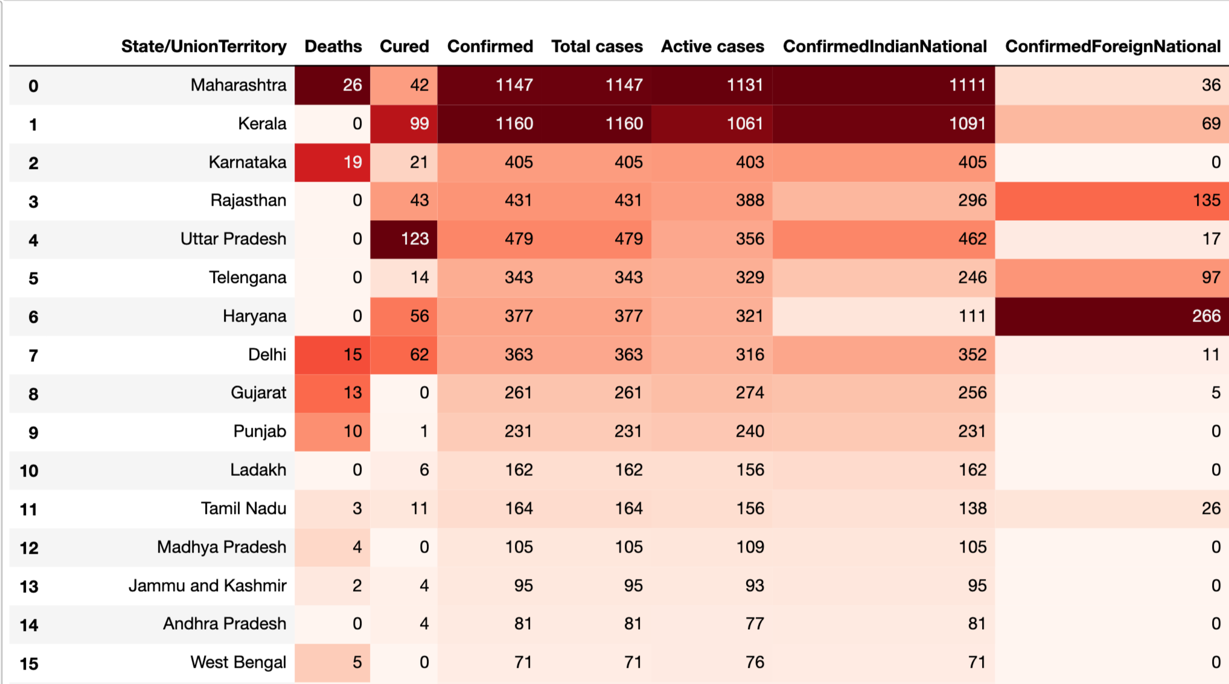
State Wise Distribution

Slide 37
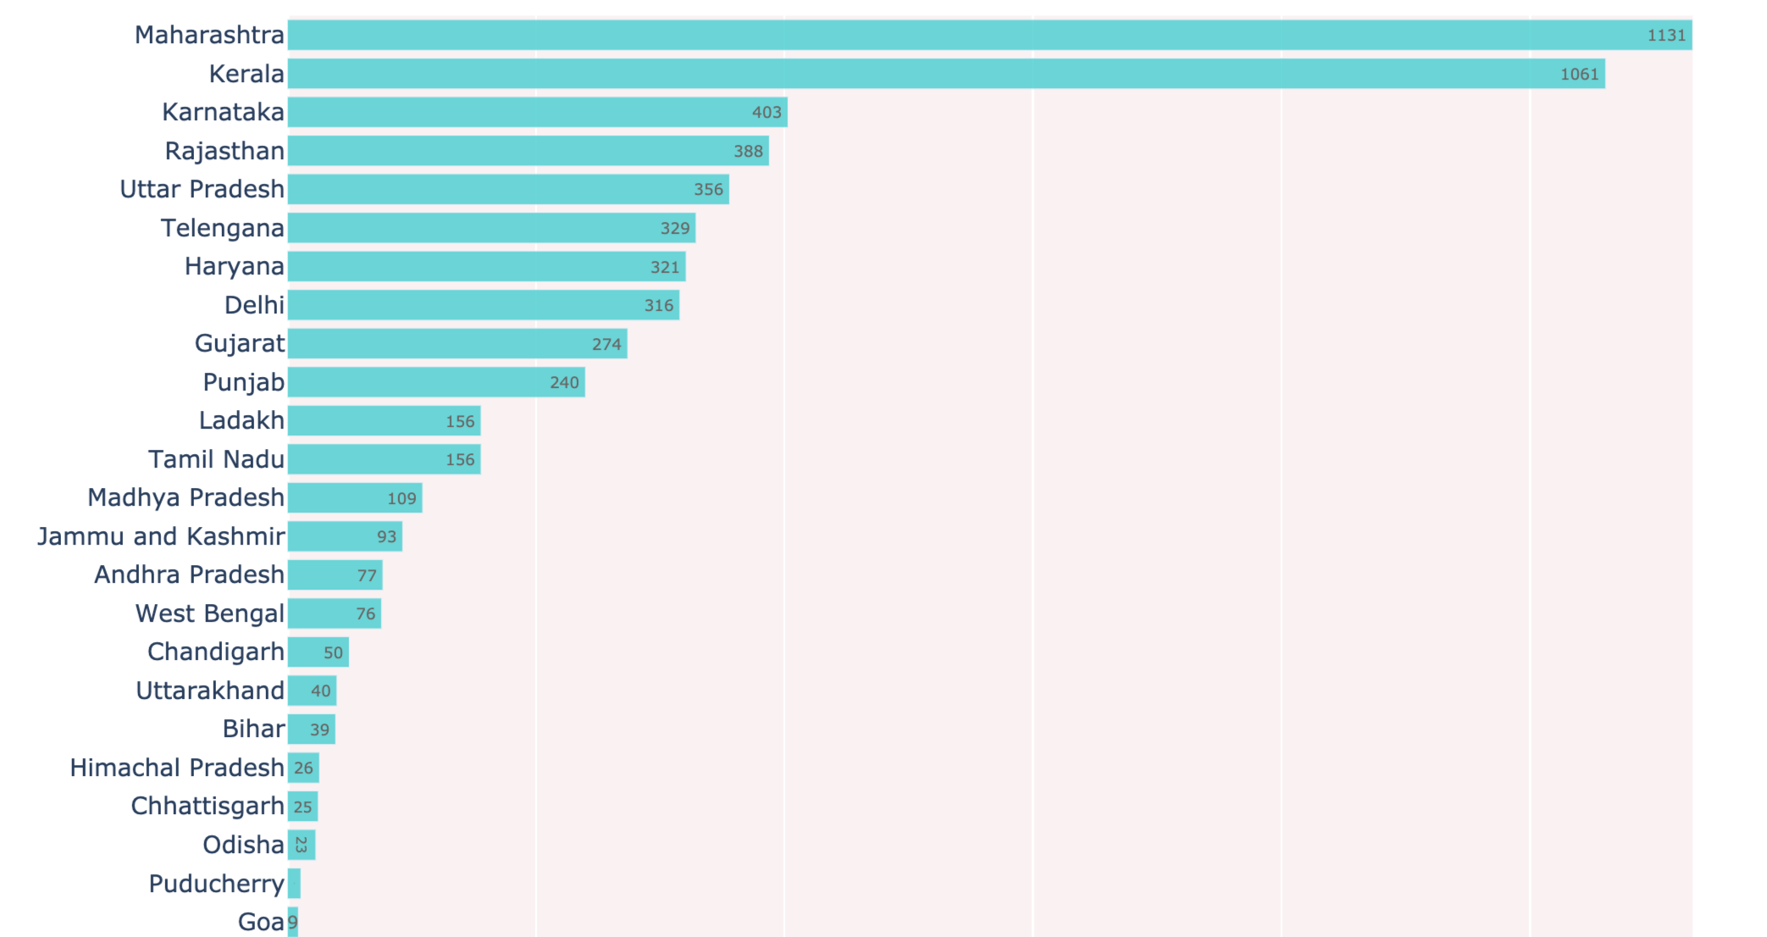
Bar Diagram of Total Active Cases(State wise)

Slide 38
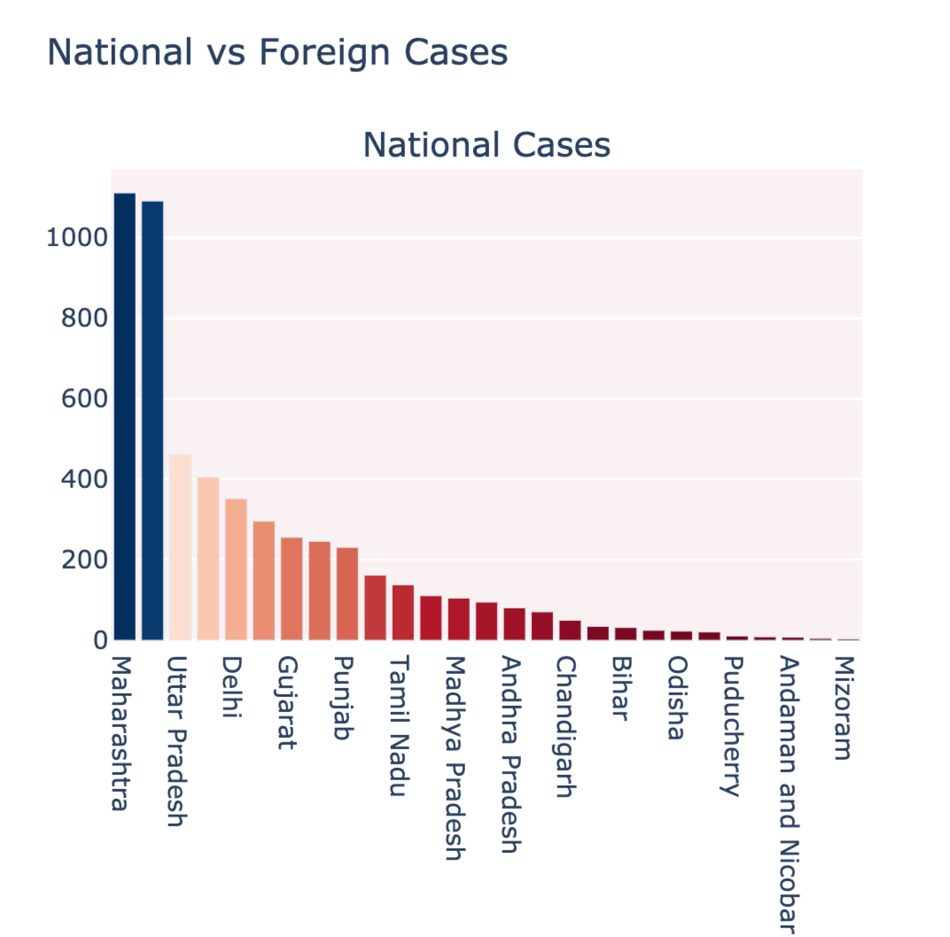
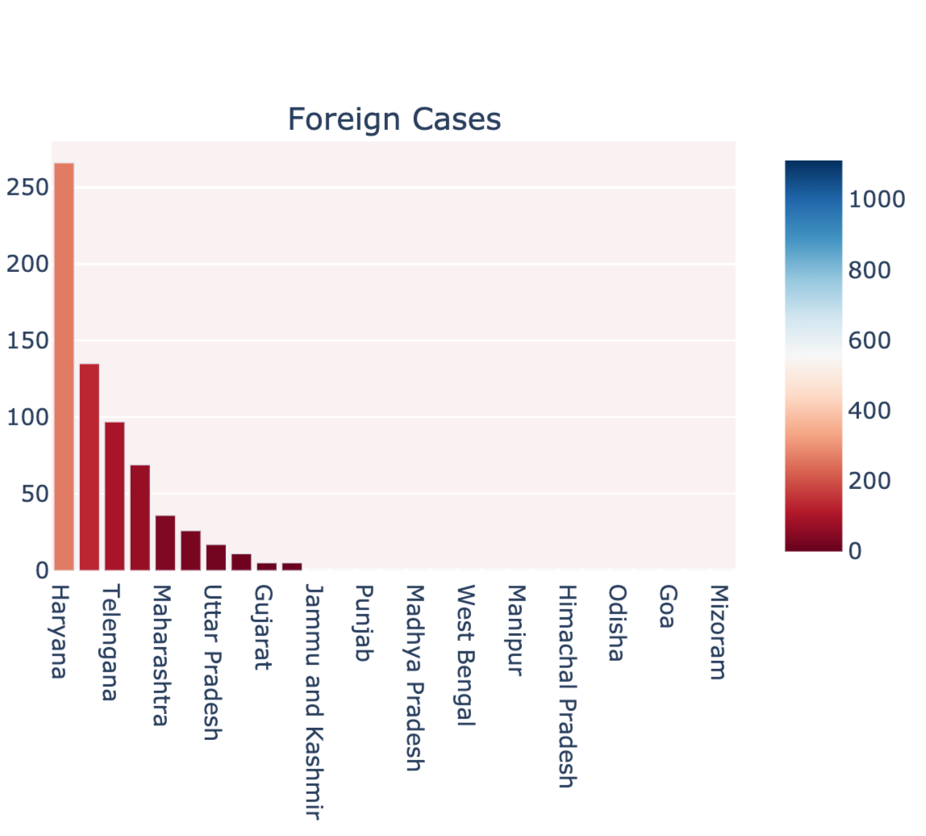
India vs Foreign Cases (State wise Bar Diagram)

Slide 39
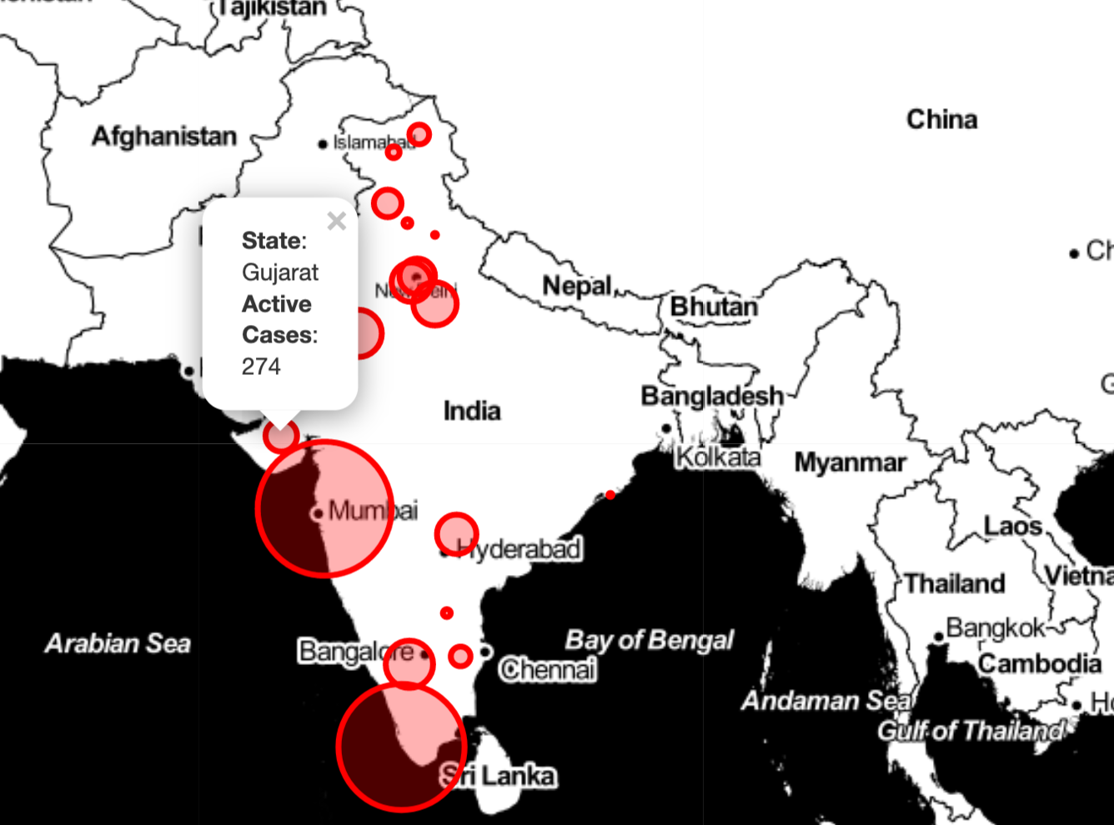
Visualizing the spread geographically

Slide 40
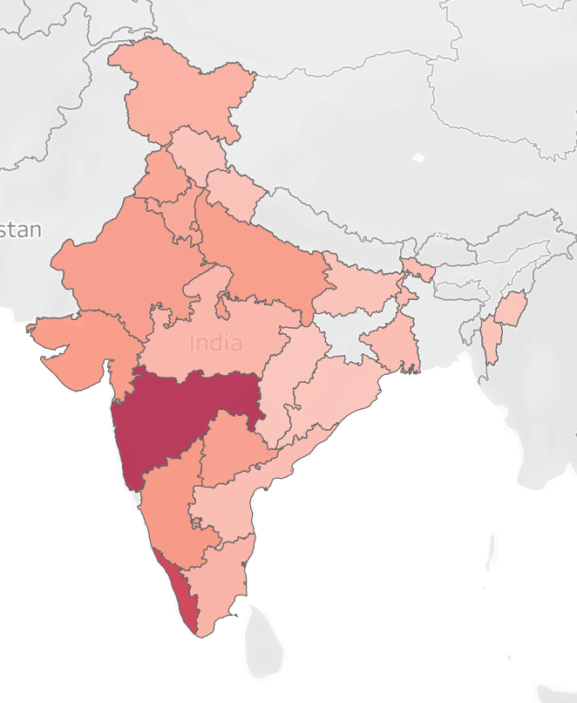
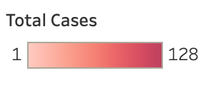
Affected States/UT’s in India (First 128 Cases)

Slide 41
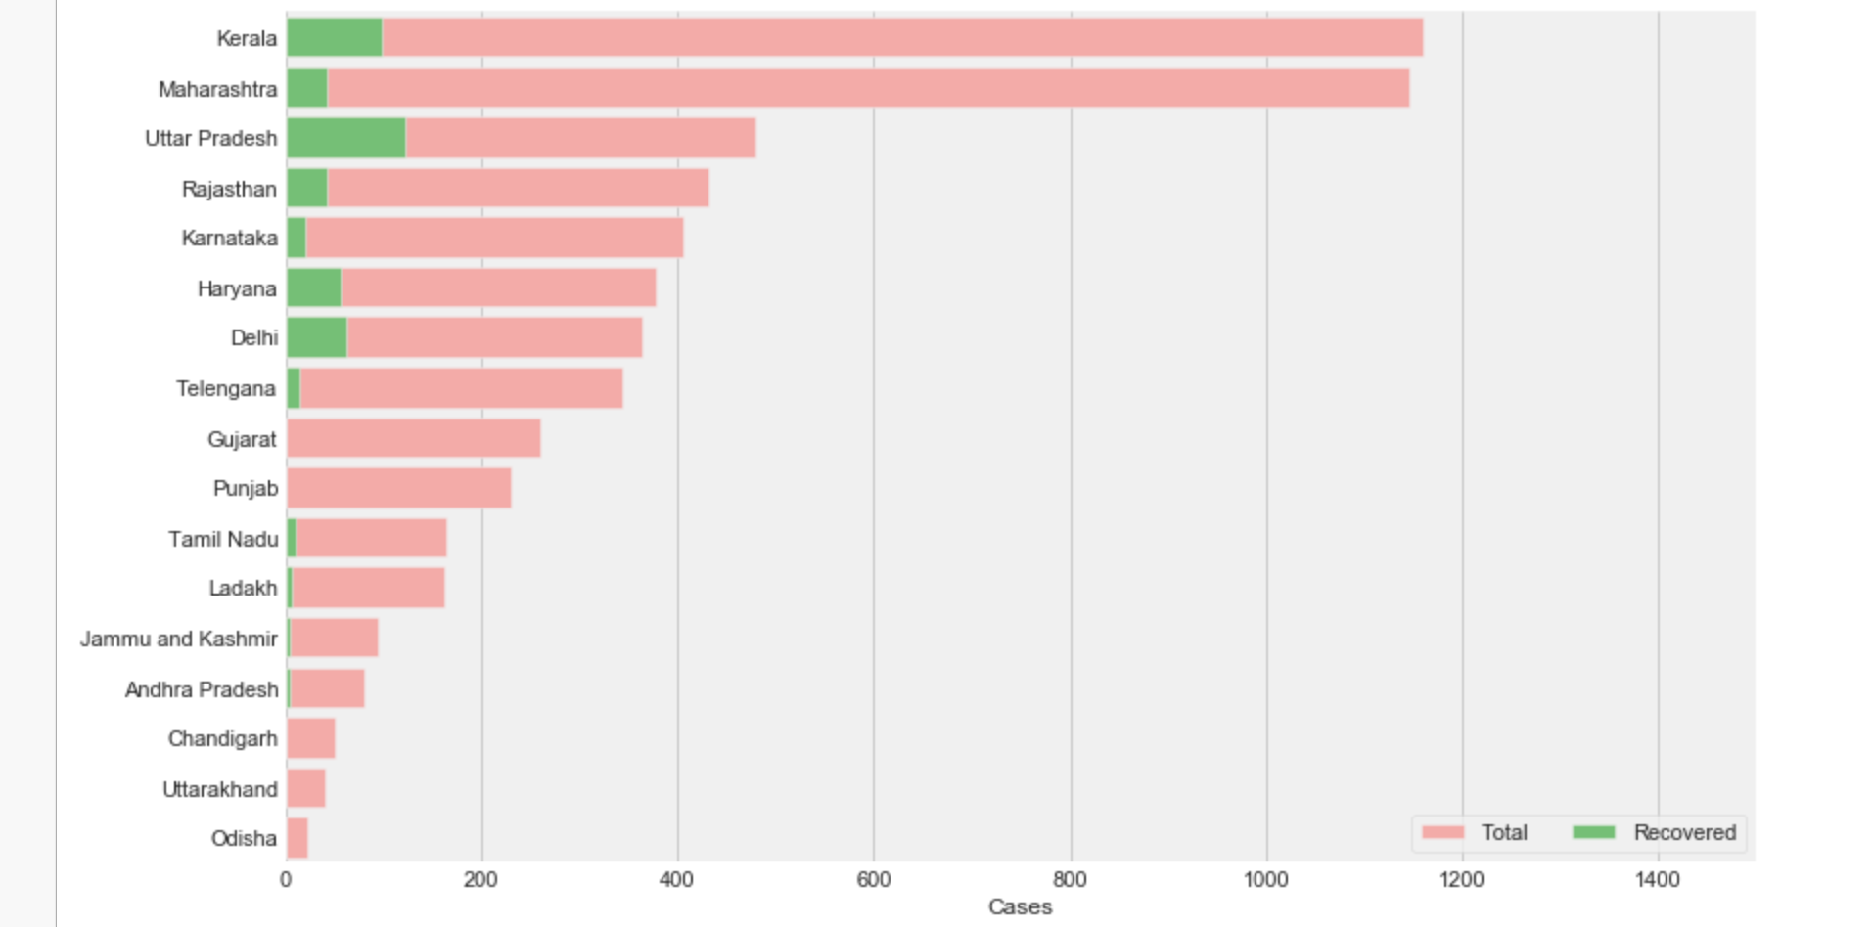
Confirmed vs Recovered figures

Slide 42
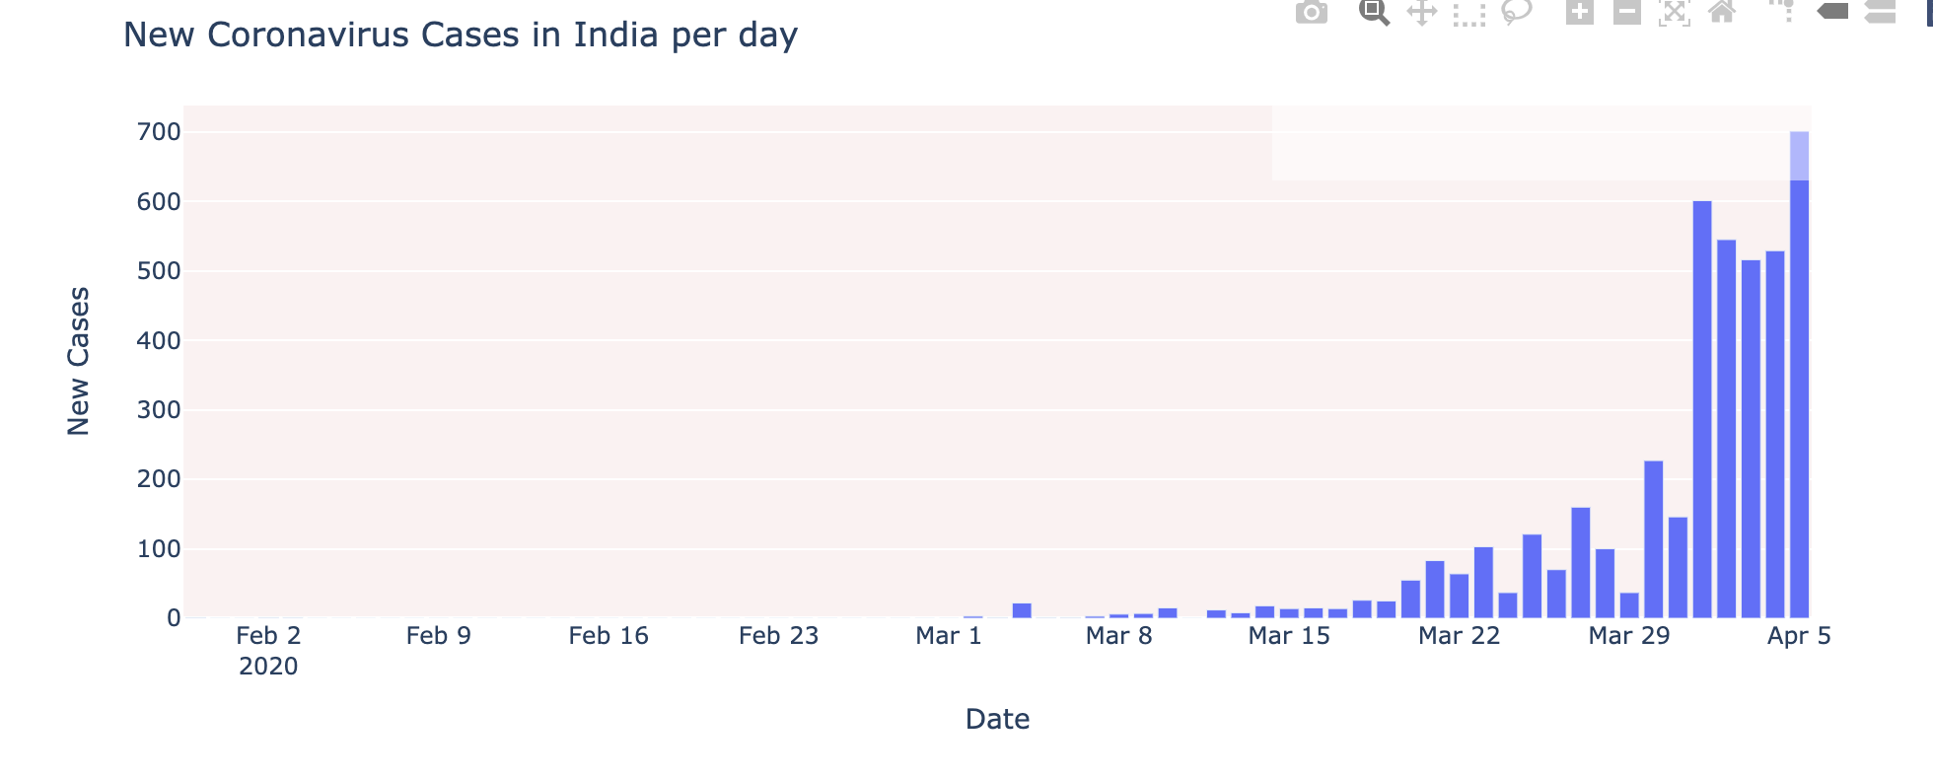
How the Coronavirus cases are rising?

Slide 43
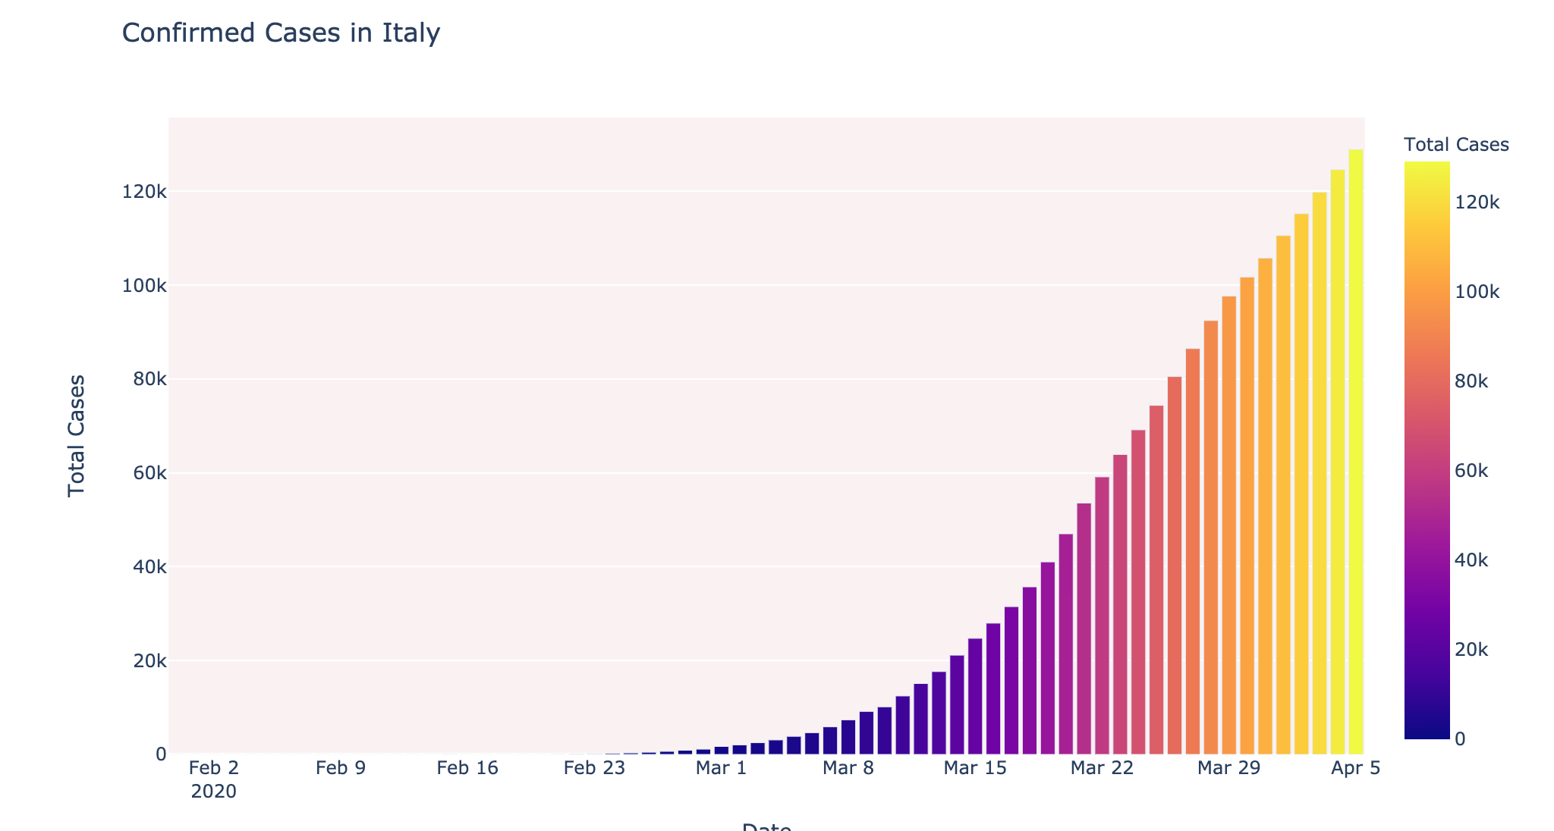
Date wise cases in Italy

Slide 44
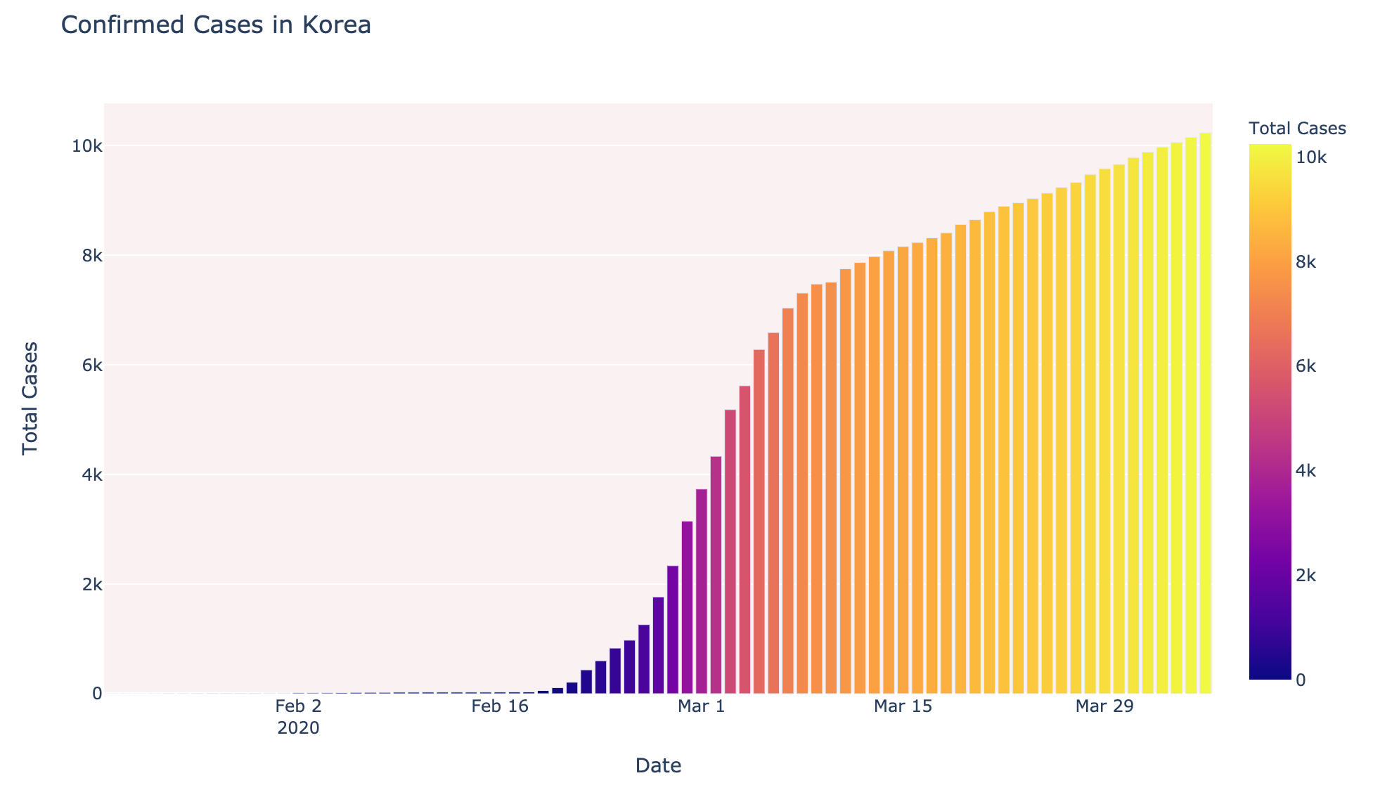
Date wise cases in S.Korea

Slide 45
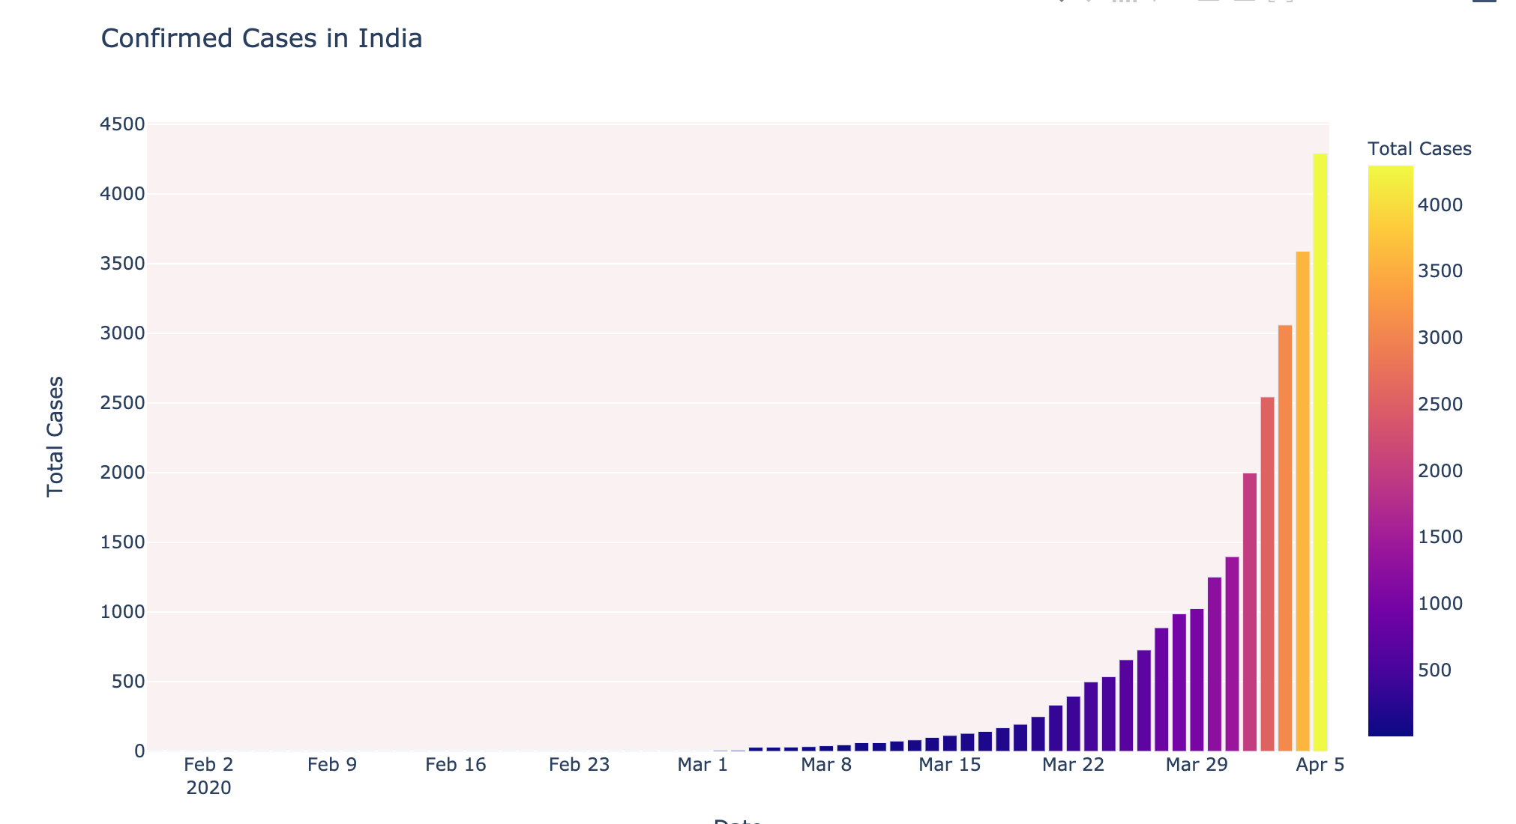
Date wise cases in India

Slide 46
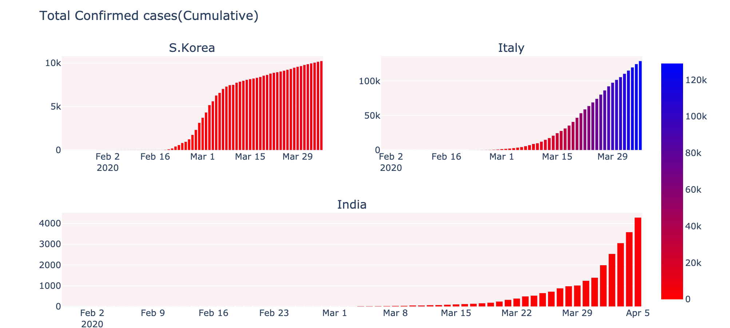
Comparison between the rise of cases in S.Korea, Italy and India

Slide 47
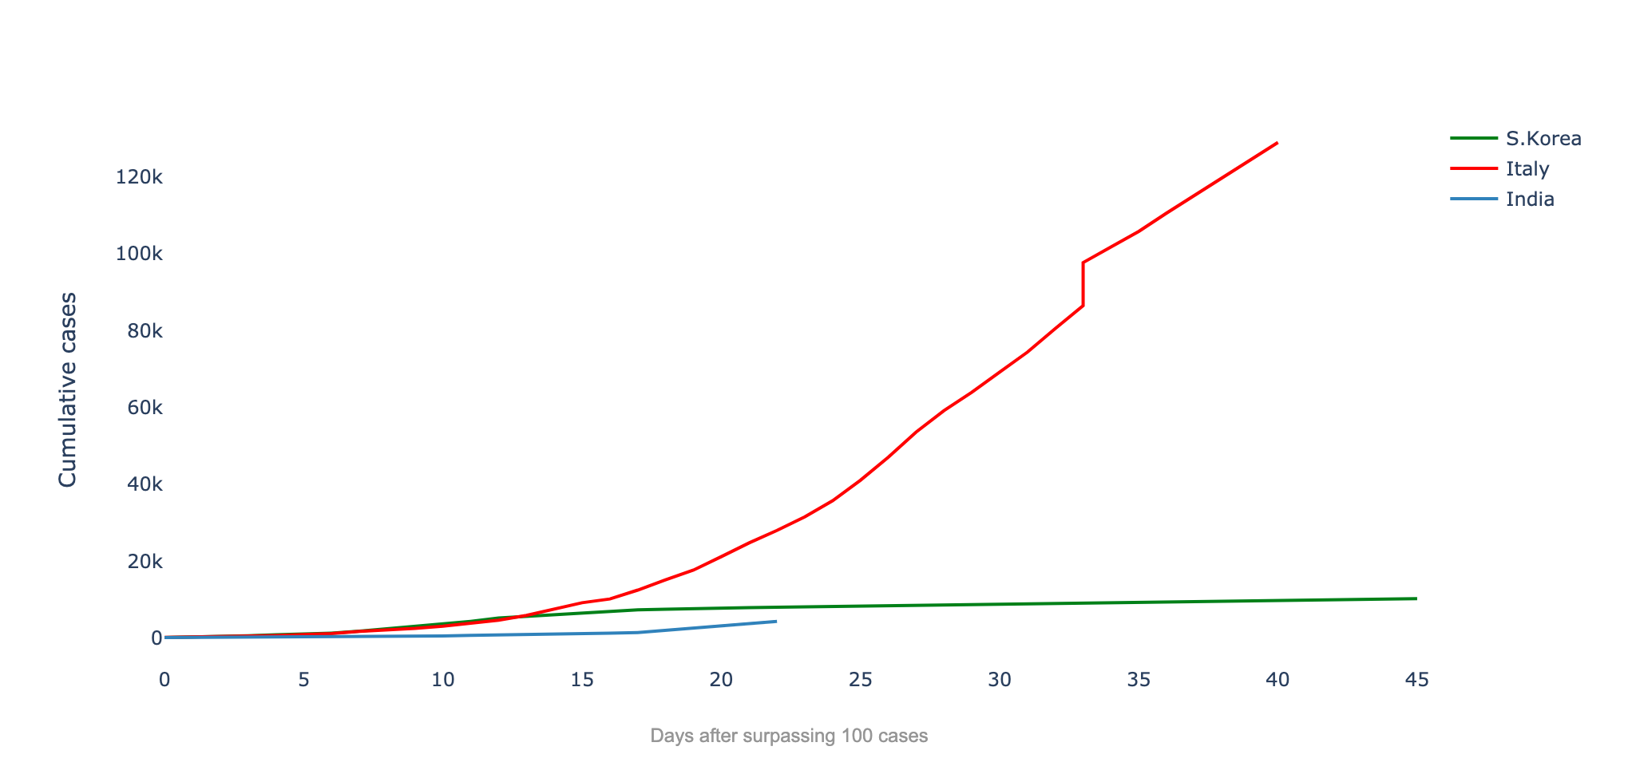
Trend after surpassing 100 cases

Slide 48

Sentimental Analysis
Sentiment analysis is the interpretation and classification of emotions within text data
Analysis
Reddit Comment Analysis
Twitter Sentimental Analysis

Slide 49

Reddit Comment Analysis
Analysis of the sentiment of approximately 50000 Reddit user's comments related to the disease starting from the 31st of December 2019

Slide 50
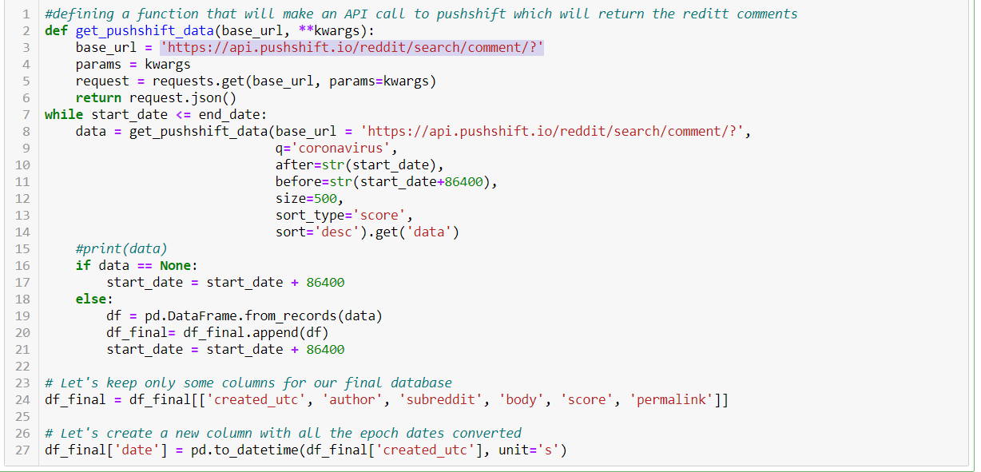
Methodology
1) Retrieved the comments made on Reddit containing the word 'coronavirus' using Pushshift API

Slide 51
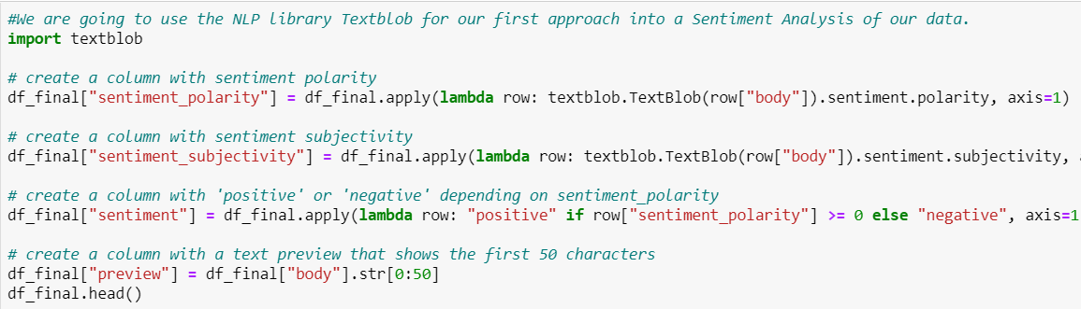
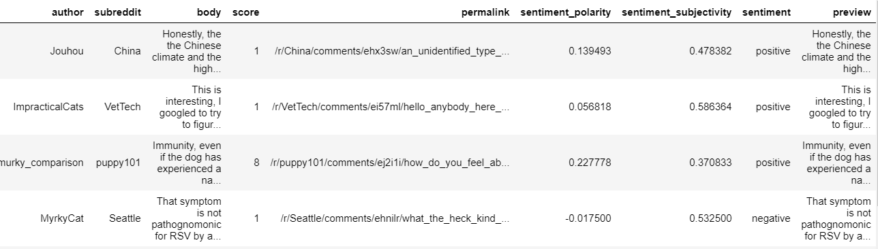
NLP
Data Clean and Used the NLP library Textblob

Slide 52
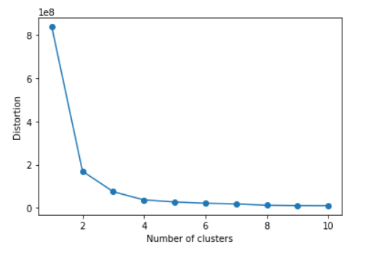
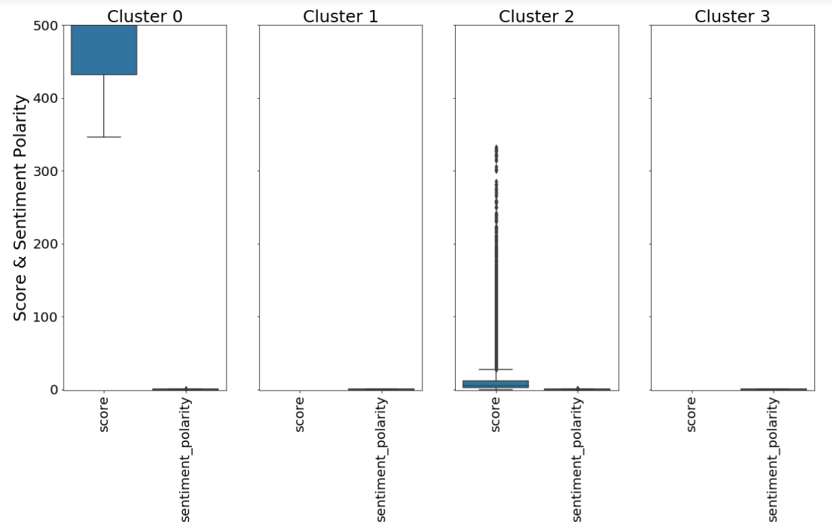
K-Means Clustering
Used K-means clustering to classify the comments in different clusters
Used the Elbow Method to determine the best value for k.

Slide 53
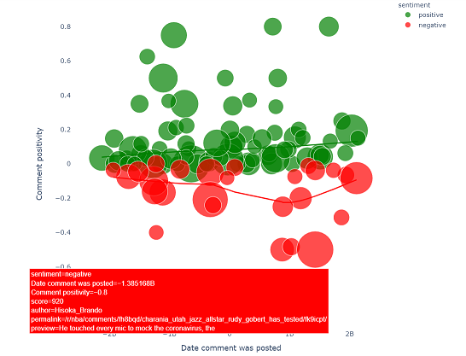
Visualization
A graphic to see if there have been more positive or negative comments on the coronavirus.

Slide 54

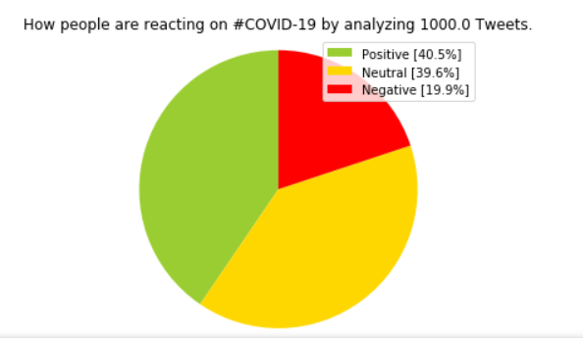
Sentimental Analysis on Twitter Data
Used tweepy to fetch most recent tweets on COVID-19
Analysis using Textblob library

Slide 55
Conclusion
Through Research Analysis we understood about the similarities between the COVID19 and other pandemics
We also tried to explain how transmission of Corona Virus takes place and build a knowledge graph to show the relation between entity and object (Cause & Effect)
By Geospatial Analysis we were able to visualize the Corona Virus cases across the globe and plot heat map
Time Series Forecasting helped us in predicting the future trend of COVID19 cases all over the world
Sentiment Analysis helped us in analyzing the attitude and emotion of the general public from different countries through their comments and tweets on Reddit, Twitter respectively. We see there’s a massive negative emotion among people but we also saw a very big no of people showing hope and positivity amidst this chaos.
The EDA helped us to determine the conditions prevailing in India and how India is tackling this pandemic compared to different countries. South Korea and India has been successful so far in tackling this deadly disease whereas Italy is facing a crisis

Slide 56
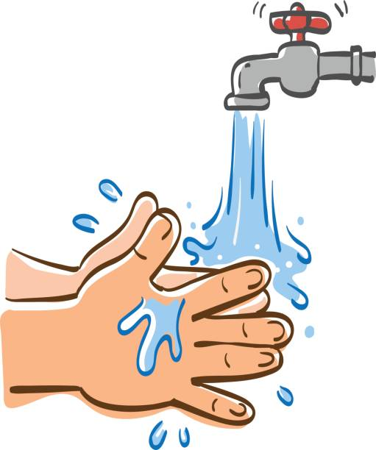
STAY SAFE
DON’T PANIC
Wash Your Hands
THANK YOU

